Slide 1
RATP Clustering
Saffian Asghar
Emilio Espinosa Sanchez

Slide 2
WORKFLOW
EDA
Analyze the data, filter significant attributes, substitute missing values
NORMALIZE DATA
Scale the data
MODEL
Select and build suitable models depending upon your data
COMPARISON AND REGRESSION
Train your model and test it with an unseen sample.
Compare different models results and accuracy

Slide 3

EDA
Variables to analyze air quality:
Weather parameters:
Humidity (HUMI).
Temperature (TEMP).
Air renewal:
Carbon dioxide (CO2).
Quality of air:
Nitrogen oxide (NO, NO10).
Particles (PM10, PM2.5).

Slide 4
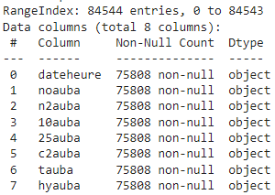
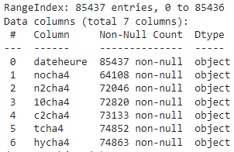
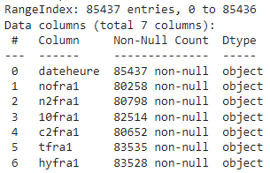
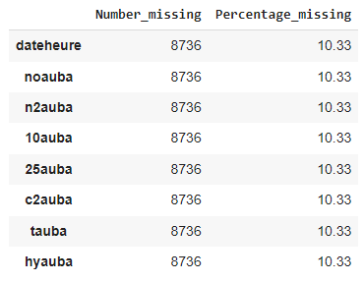
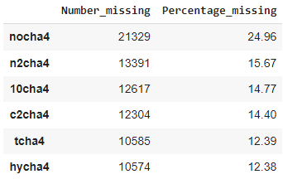
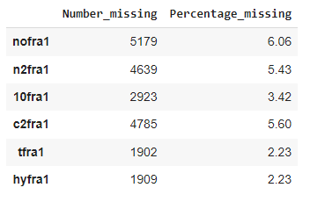
EDA
AUBER
CHATELET
FRANKLIN

Slide 5
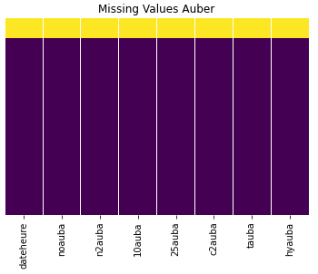
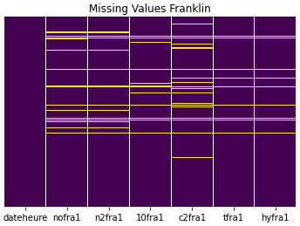
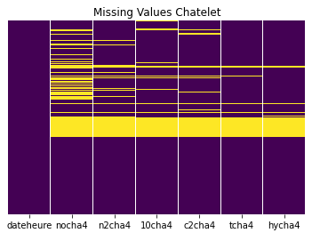
EDA
AUBER
FRANKLIN
CHATELET

Slide 6
EDA
Replacement of “,” for “.”
Replacement of “ND” values for None.
Take out “>” and “<” signs.
Convert columns to numeric format.
Date/Time column to date time format.
Drop rows with more than one missing value.
Replace rest of missing values with the mean grouped by date and time.

Slide 7
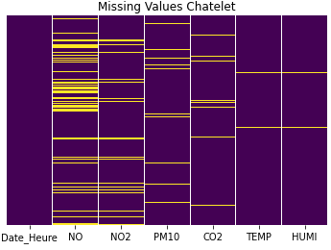
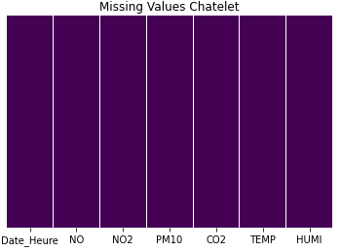

EDA

Slide 8
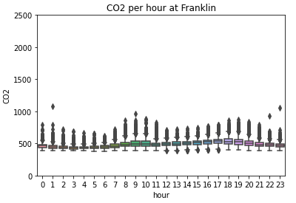
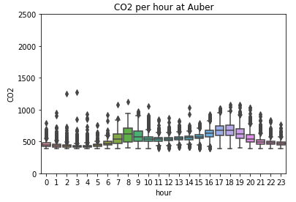
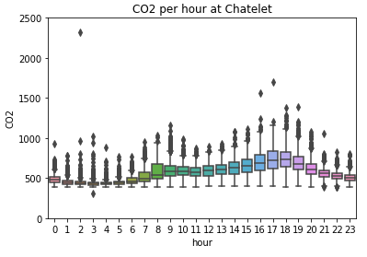
EDA
Divide date/time value in: weekday, month, year and hour.

Slide 9
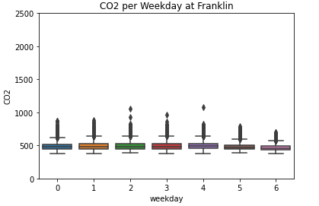
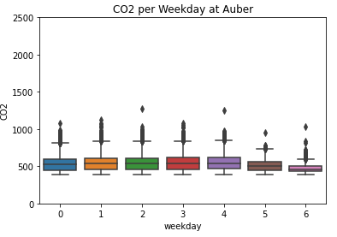
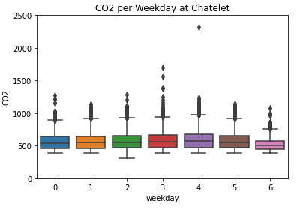
EDA

Slide 10
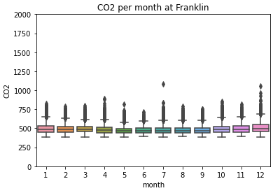
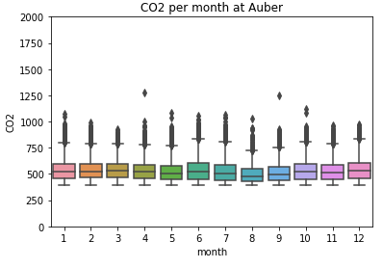
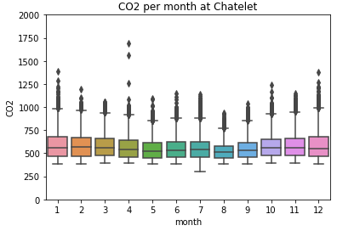
EDA

Slide 11
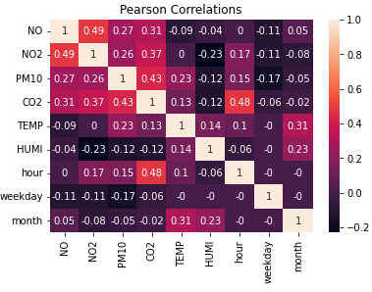
EDA-CORRELATIONS
CHATELET

Slide 12
Clustering

Slide 13
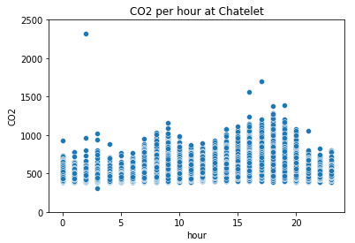
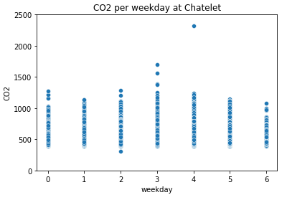
Chatelet data
Notes:
# Accuracy: how good we were in recognizing positive and negative
# Precision: how correct the classifier is
# Recall: how complete the classifier is
# F-Score: combination of presition and recall

Slide 14
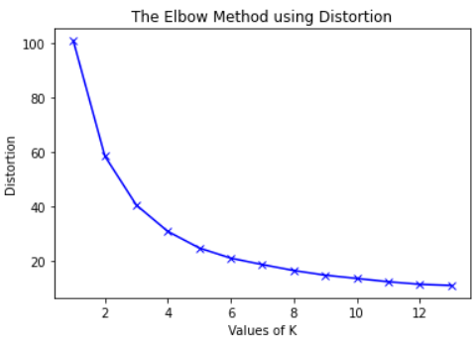
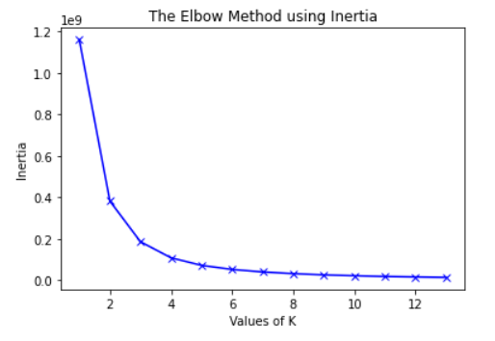
Elbow Method for hours
Distortion: Average of the squared distances from the cluster centers of the respective clusters.
Inertia: Sum of squared distances of samples to their closest cluster center.
To determine the optimal number of clusters, we have to select the value of k at the “elbow” ie the point after which the distortion/inertia start decreasing in a linear fashion
Notes:
# Accuracy: how good we were in recognizing positive and negative
# Precision: how correct the classifier is
# Recall: how complete the classifier is
# F-Score: combination of presition and recall

Slide 15
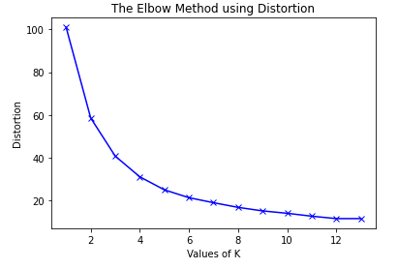
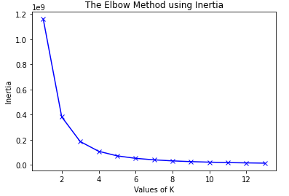
Elbow Method for weekdays
Notes:
# Accuracy: how good we were in recognizing positive and negative
# Precision: how correct the classifier is
# Recall: how complete the classifier is
# F-Score: combination of presition and recall

Slide 16
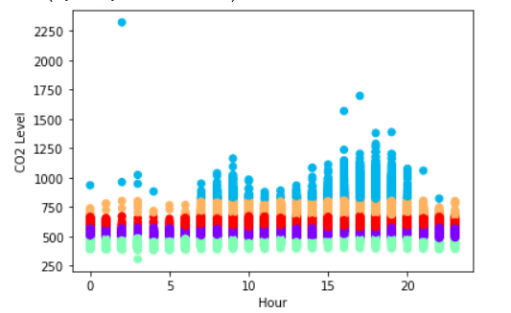
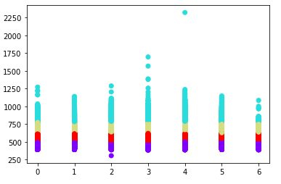
Chatelet data
Hours vs CO2
Weekdays vs CO2
weekday
K-Means Model for K=5
K-Means Model for K=4
Notes:
# Accuracy: how good we were in recognizing positive and negative
# Precision: how correct the classifier is
# Recall: how complete the classifier is
# F-Score: combination of presition and recall

Slide 17
Cluster Evaluation Metrics
Silhouette Score:
Studies the separation between clusters. It ranges from [-1,1].
Closer to 1 = more separation.
Closer to 0 = sample is on or very close to decision boundary.
Closer to -1 = samples could have been assigned to the wrong cluster.
.
Notes:
Silhouette: It is calculated by using the mean of the distance of the intra-cluster and nearest cluster for all the samples.

Slide 18
Cluster Evaluation Metrics
Calinski Harabaz Index:
It is based on the principle of variance ratio. This ratio is calculated between two parameters within-cluster diffusion and between cluster dispersion.
The higher the better
.
Notes:
Silhouette: It is calculated by using the mean of the distance of the intra-cluster and nearest cluster for all the samples.

Slide 19
Cluster Evaluation Metrics
Davies Bouldin Index:
It is based on the principle of with-cluster and between cluster distances. It is commonly used for deciding the number of clusters in which the data points should be labeled.
The smaller the value the better
.
Notes:
Silhouette: It is calculated by using the mean of the distance of the intra-cluster and nearest cluster for all the samples.

Slide 20
Cluster Evaluation Metrics
Metrics for Hour/CO2 cluster
Metric | K = 2 | K = 3 | K = 4 | K = 5 | K = 6
Silhouette Coefficient | 0.605 | 0.575 | 0.565 | 0.550 | 0.538
Calinski-Harabasz | 145 909 | 186 395 | 227 867 | 263 161 | 290 805
Davies-Bouldin | 0.572 | 0.546 | 0.529 | 0.529 | 0.536
Notes:
Silhouette: It is calculated by using the mean of the distance of the intra-cluster and nearest cluster for all the samples.

Slide 21
Cluster Evaluation Metrics
Metrics for Weekday/CO2 cluster
Metric | K = 2 | K = 3 | K = 4 | K = 5 | K = 6
Silhouette Coefficient | 0.609 | 0.582 | 0.574 | 0.563 | 0.553
Calinski-Harabasz | 146 882 | 188 629 | 232 131 | 270 139 | 301 539
Davies-Bouldin | 0.566 | 0.541 | 0.522 | 0.514 | 0.518
Notes:
Silhouette: It is calculated by using the mean of the distance of the intra-cluster and nearest cluster for all the samples.

Slide 22
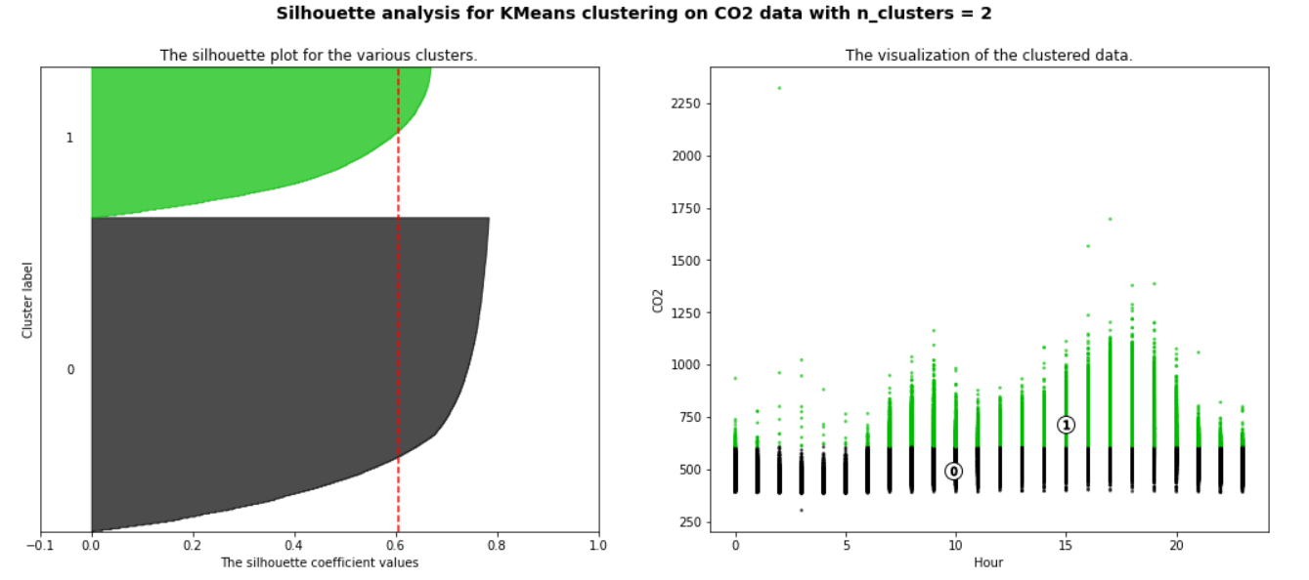
Silhouette Analysis on CO2 Levels based on hours
For n_clusters = 2 The average silhouette_score is : 0.60
Notes:
# Accuracy: how good we were in recognizing positive and negative
# Precision: how correct the classifier is
# Recall: how complete the classifier is
# F-Score: combination of presition and recall

Slide 23
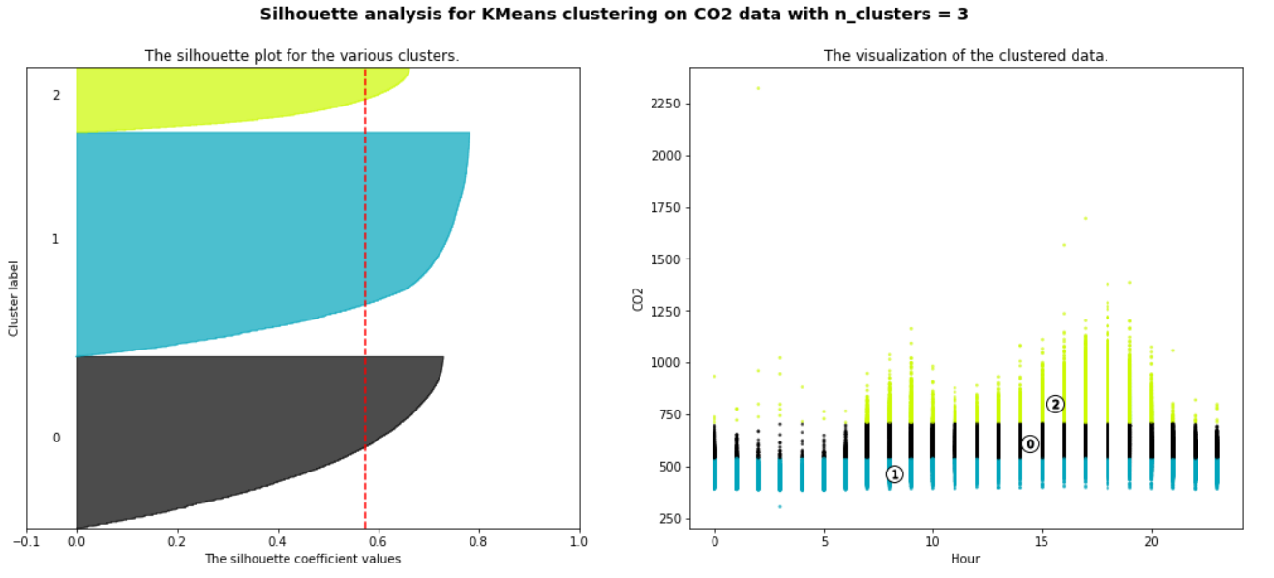
Silhouette Analysis on CO2 Levels based on hours
For n_clusters = 2 The average silhouette_score is : 0.57
Notes:
# Accuracy: how good we were in recognizing positive and negative
# Precision: how correct the classifier is
# Recall: how complete the classifier is
# F-Score: combination of presition and recall

Slide 24
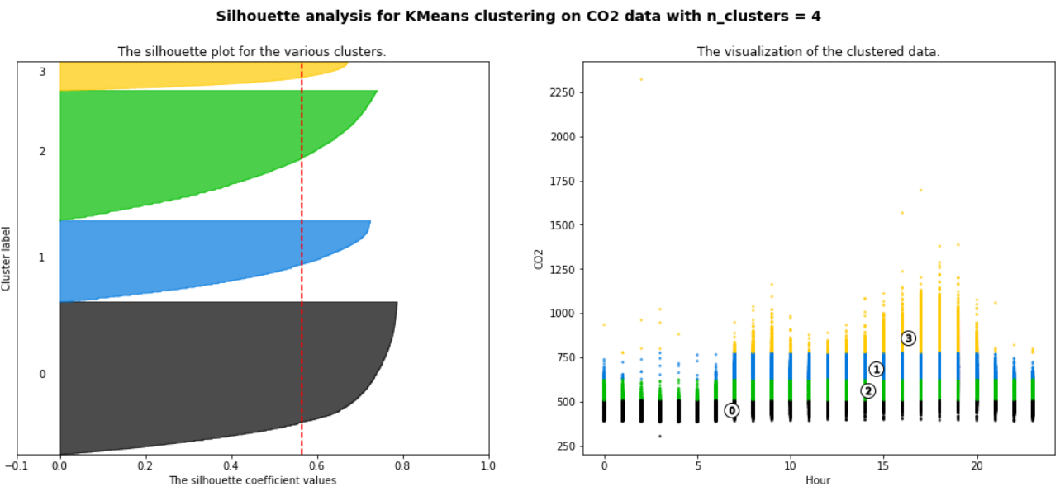
Silhouette Analysis on CO2 Levels based on hours
For n_clusters = 2 The average silhouette_score is : 0.56
Notes:
# Accuracy: how good we were in recognizing positive and negative
# Precision: how correct the classifier is
# Recall: how complete the classifier is
# F-Score: combination of presition and recall

Slide 25
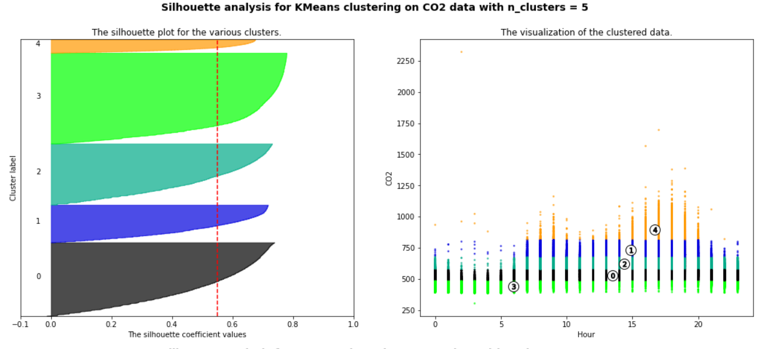
Silhouette Analysis on CO2 Levels based on hours
For n_clusters = 2 The average silhouette_score is : 0.55
Notes:
# Accuracy: how good we were in recognizing positive and negative
# Precision: how correct the classifier is
# Recall: how complete the classifier is
# F-Score: combination of presition and recall

Slide 26
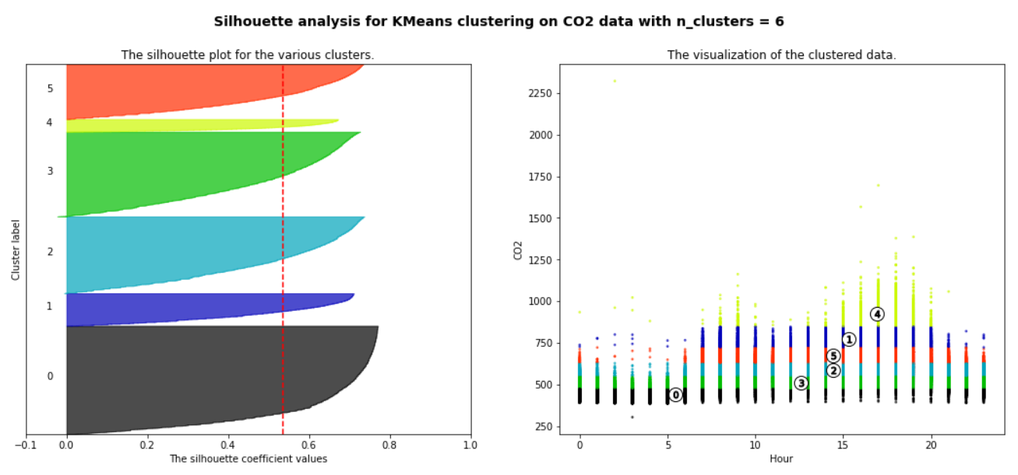
Silhouette Analysis on CO2 Levels based on hours
For n_clusters = 2 The average silhouette_score is : 0.53
Notes:
# Accuracy: how good we were in recognizing positive and negative
# Precision: how correct the classifier is
# Recall: how complete the classifier is
# F-Score: combination of presition and recall

Slide 27
THANK YOU
Saffian
Emilio

